Slide 1

Information sharing protocol
31 May 2022

Slide 2
Purpose and objectives
Conduct joint analysis and avoid the duplication of data management efforts
Better triangulation of information
Be able to provide regular, credible situation analyses, response monitoring, reporting and recommendations
Improved inter-agency collaboration
Improved protection of and response to affected populations

Slide 3
Data sensitivity
If sensitive data is disclosed or accessed without proper authorisation, it is likely to cause:
Harm (physical and psychological harm, discrimination and the denial of access to services)
A negative impact on the capacity of an organisation or the broader humanitarian community to carry out its activities
An erosion of trust within the humanitarian community or between humanitarian actors and key stakeholders

Slide 4
Proposed actions
Pseudonymisation of partners
Already underway
Limited impact on ease of reporting
Greater reporting opportunities
Classification of data and information
Two-step process
Template under development

Slide 5
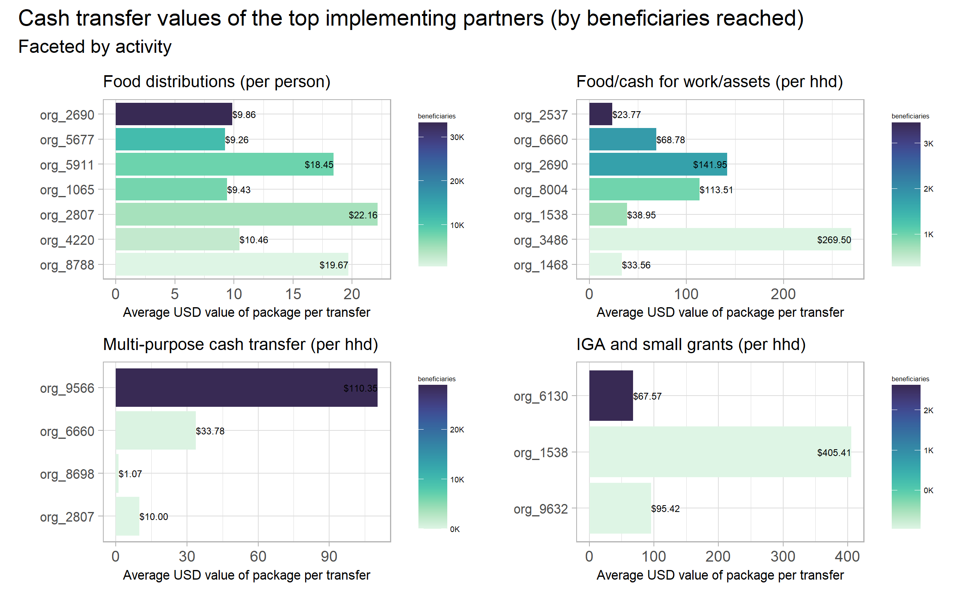

Slide 6
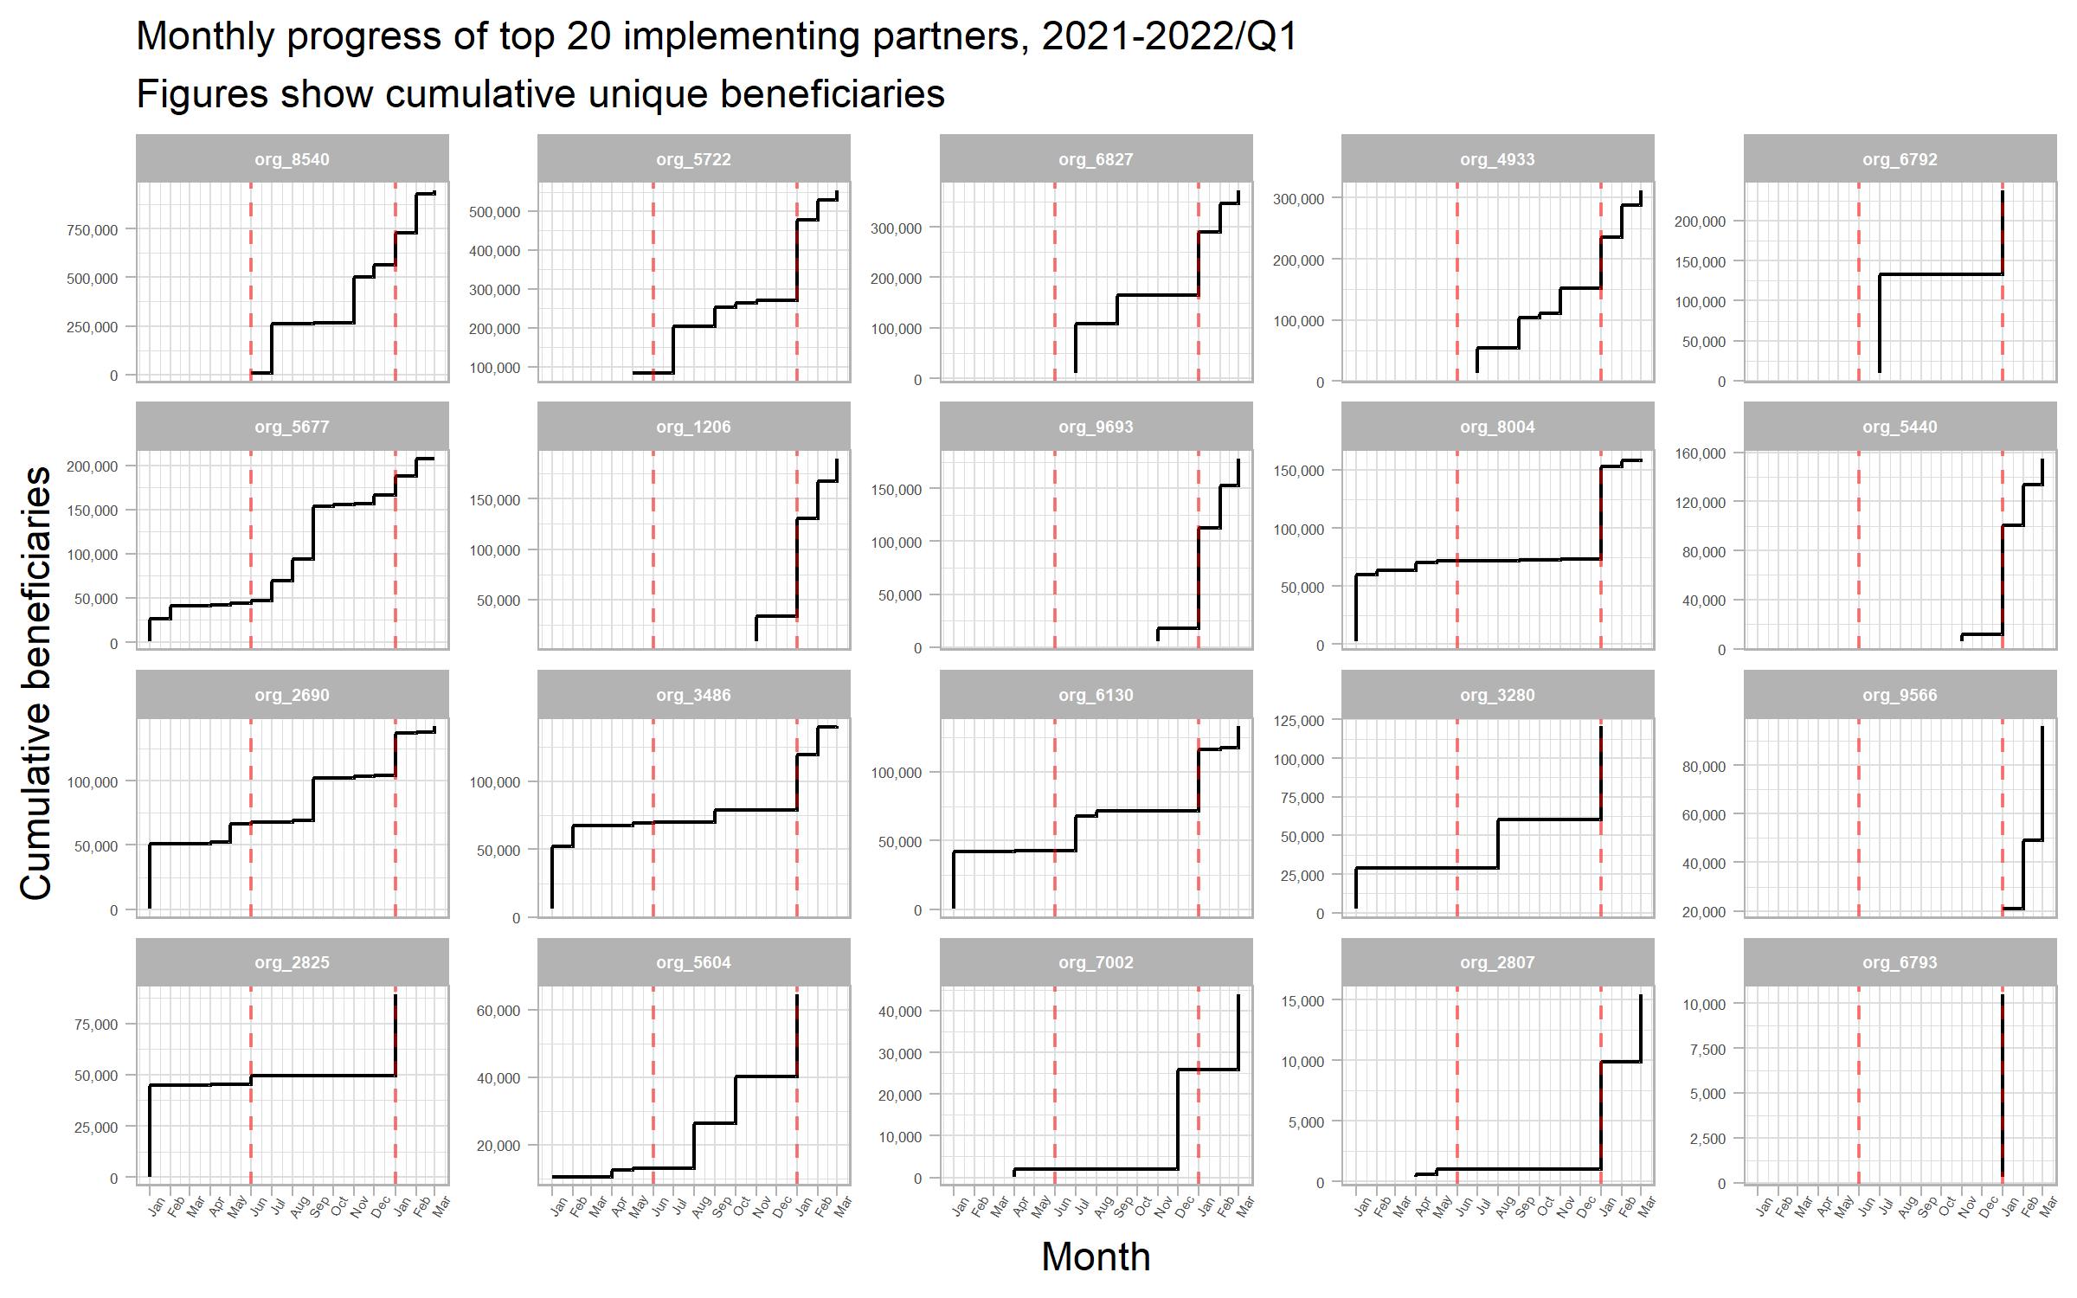

Slide 7
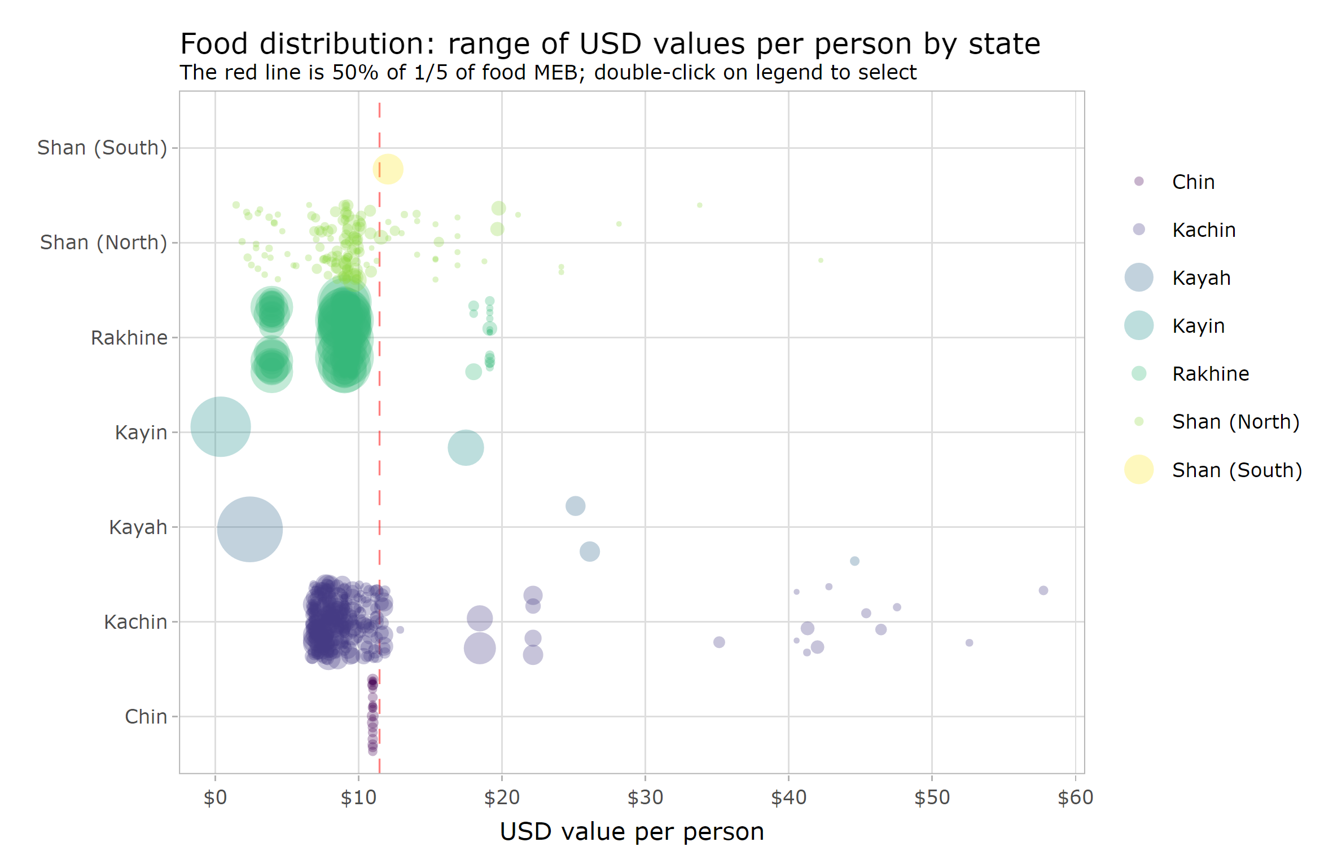

Slide 8
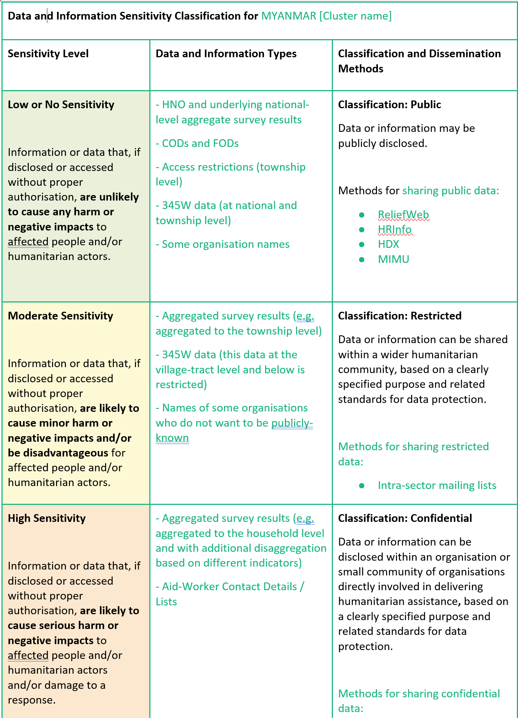

Slide 9
Information sharing protocol
31 May 2022

